Slide 1
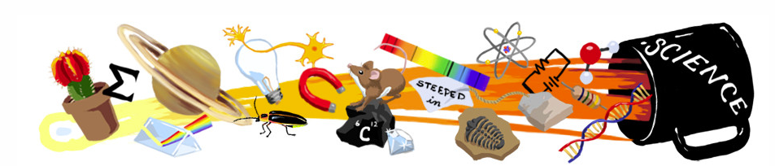
SCIENCE @ home!

Slide 2
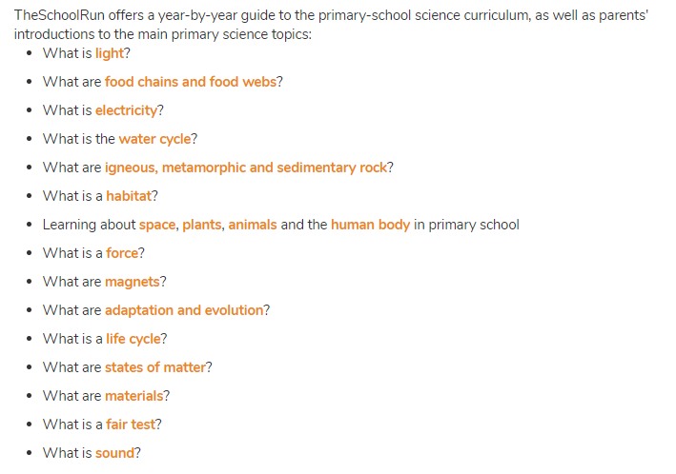
Primary science curriculum for parents
https://www.theschoolrun.com/primary-science-what-you-need-know

Slide 3



https://www.winchestersciencecentre.org/science-home/science-home/#.Xpay6MhKi70
This great site adds new ideas and materials every Sunday. Suitable for ks1 and ks2. with a grown ups guide for each challenge the whole family can get involved!

Slide 4

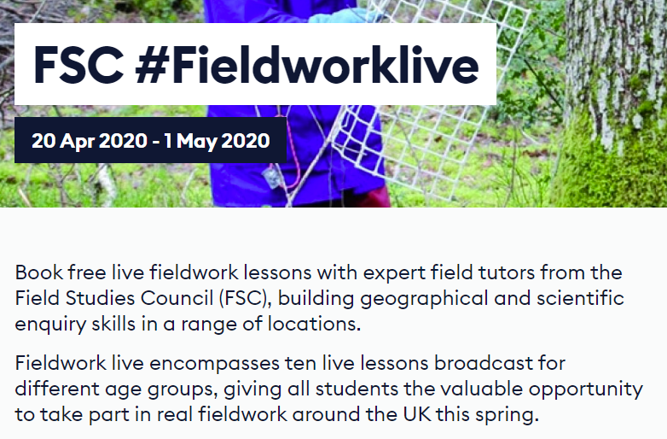
– science and geography
The FSC (Field Studies Council) is offering live fieldwork lessons and has lots of ideas for outdoor learning activities for FS, KS1 and KS2 children and their families
You can also find simple activity suggestions to do in a garden or green space e.g. create a sound map
https://encounteredu.com/live-lessons/fsc-fieldworklive-2020?ref=email&dm_i=65YE,YI1,K49N5,3BR3,1

Slide 5

Dr Maggie & Lori’s you tube channel
Dr Maggie and her daughter’s new you tube channel: beyond the earth with lots of ‘I wonder’ questions to discuss and research – links to school curriculum
featured regularly on the radio 2 breakfast show!
https://www.youtube.com/watch?v=21it3GCaUcA

Slide 6
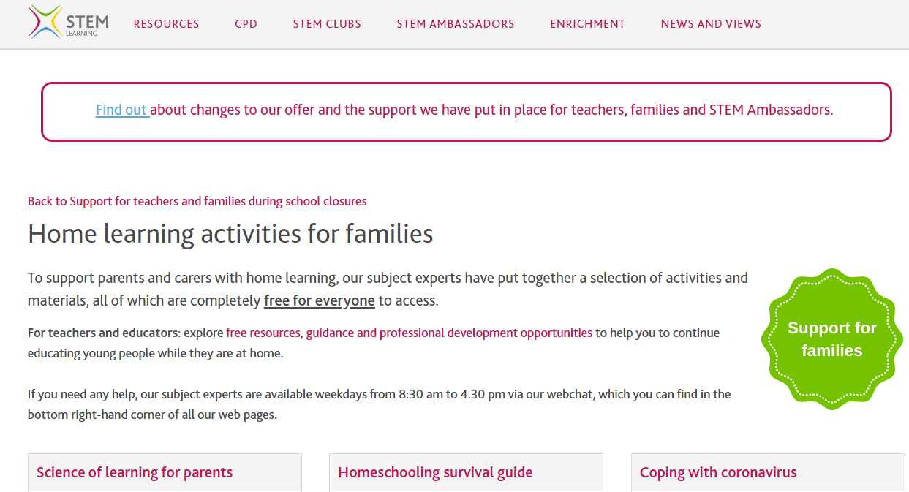
stem
STEM – free resources for teachers and families
Tried and tested experiments and ideas to find science all around your home
https://www.stem.org.uk/home-learning
https://www.stem.org.uk/home-learning/primary - to quickly select age appropriate activities, fs to upper ks2

Slide 7
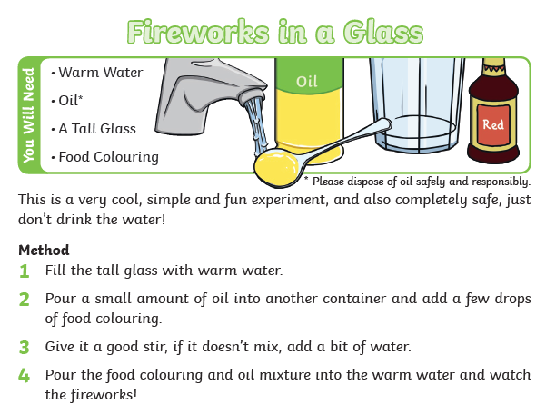
TWINKL – Free ‘science at home’ activities
https://www.twinkl.co.uk/resource/t-t-8917-science-experiments-at-home

Slide 8
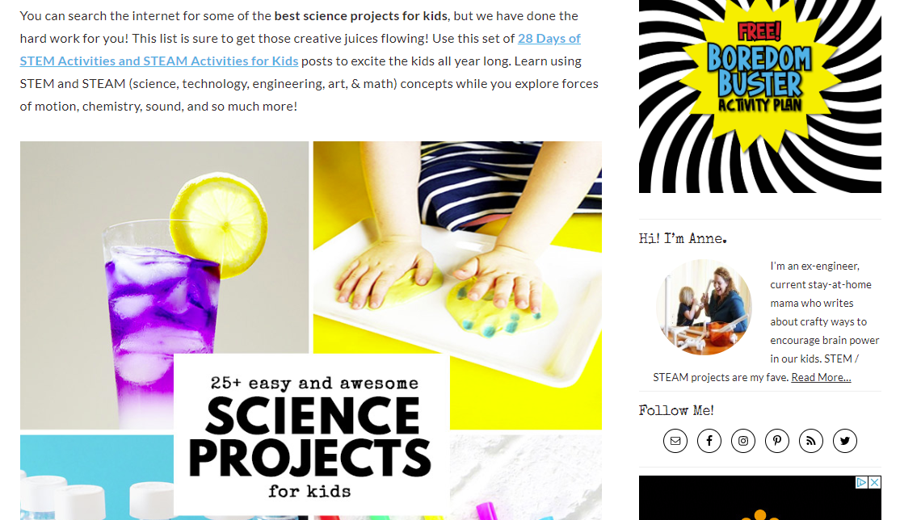
Steam learning & teaching ideas
Incorporate and link art to stem activities
https://theartofeducation.edu/packs/infuse-curriculum-design-thinking/
https://leftbraincraftbrain.com/easy-awesome-science-projects-for-kids/
https://encounteredu.com/steam-activities - FSC useful pages

Slide 9
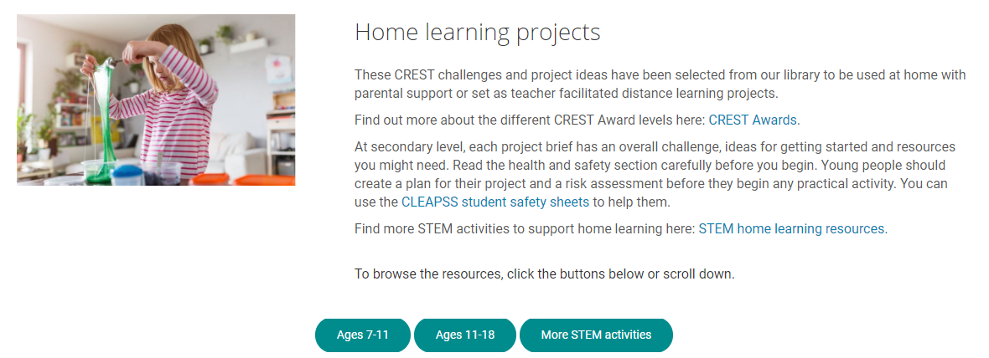
Earn awards as you complete stem projects at home with crest awards
https://collectionslibrary.crestawards.org/
A very child/parent-friendly resource where you can choose a science project to complete – all aim to use resources found in most homes.
Children can also print off a ‘passport’ to record their journey

